Slide 1
Cadence
Implementation: Past, Present, and Future

Slide 2
Implementation Language
Implemented in Go
Also considered Rust
Trade-off: Implementation/iteration speed / time to MVP > performance

Slide 3
Implementation in Go
Pros:
  Lots of expertise at Dapper Labs
  Commonly used in blockchain space
  Fast iteration / development speed
  Easily integratable into node software
  Can leverage garbage collection in Go for garbage collection in Cadence
  Can easily cross-compile (Linux, Windows, WebAssembly)
  Performance is good enough

Slide 4
Implementation in Go
Cons:
  Go is very minimalistic (no generics, structural typing, no enums, etc.) –
  Suboptimal for safely implementing a programming language
  Performance could be better

Slide 5
Implementation Language
Might implement new components or re-implement components
in another language

Slide 6
Phases
Programs are uploaded to the chain as source code
(deployed contracts, transactions, scripts)
Execution:
  Parse (syntactical analysis)
  Check (semantic analysis)
  Interpret
Optional caching of parsed programs
Checking result is elaboration (types of AST nodes)
AST and elaboration are not stored on-chain

Slide 7
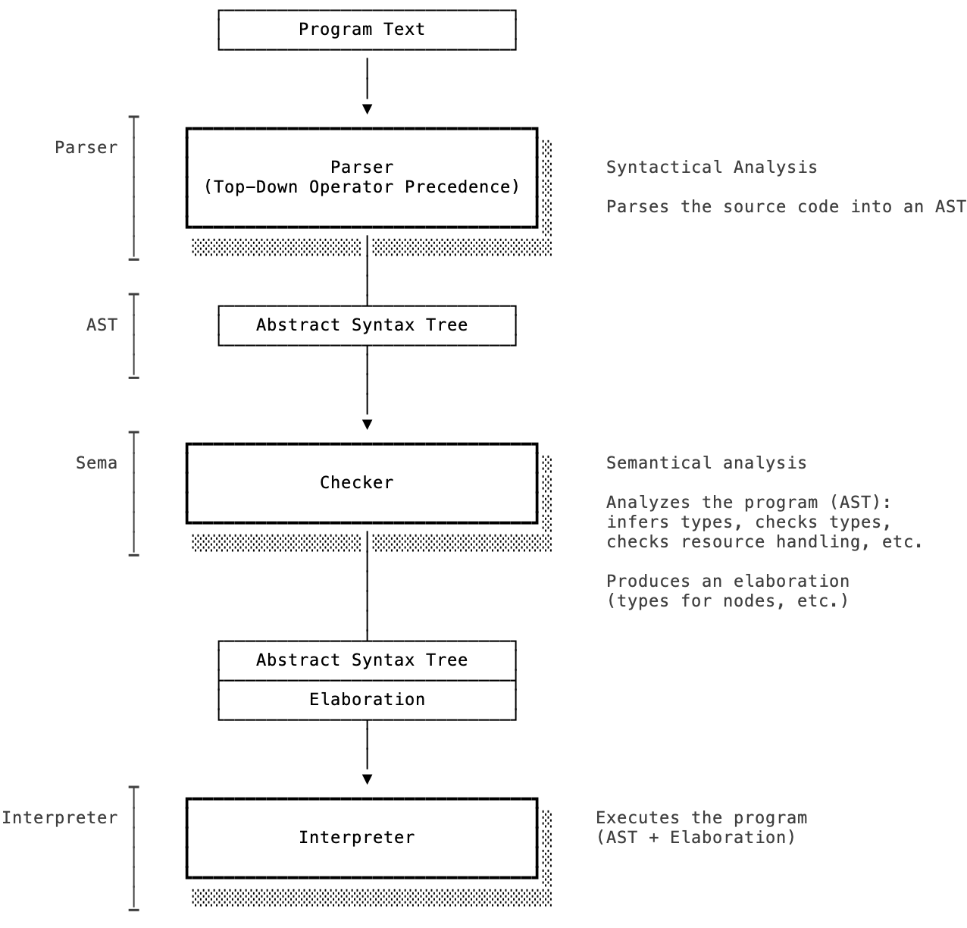

Slide 8
Parsing
Input: Source
Lexer recognizes tokens from source (e.g. identifier, string literal, etc.)
Parser:
  Hand-written Top-Down Operator Precedence (Pratt) parser
    Can declaratively specify prefix, infix, and postfix operators and their precedence
  Supports backtracking (buffering + replay) for ambiguous cases
    Less than operator vs. type argument: a<b>()
    Greater than operator vs. bitwise right shift operator: a >> b
    (again due to type arguments: a<b<c>>())
Output: AST
  JSON output for other tools

Slide 9
Parsing
Parser was initially generated using ANTLR
  Pros:
    Nice declarative grammar
    Development speed
  Cons:
    Go backend is very slow
    Hard to handle parse errors
    Hard to handle ambiguities
    Easy to introduce exponential blow-up
    Concrete Syntax Tree (CST) is additional step
    with associated overhead

Slide 10
Checking
Input: AST
Semantic analysis of program
  Type checks (e.g. subtyping, restrictions, etc.)
  Resource tracking (construction, moves, destroys)
  Interface conformance
  Type requirement conformance
  Definite initialization
  Literal range checks
  Type storability
Based on visitor over AST, breadth-first traversal
Output: Elaboration: Type information for AST nodes

Slide 11
Execution
Input: AST + Elaboration
AST-walking interpreter, uses visitor
Based on trampolining:
  Prevent stack overflow during execution
  Can halt + resume execution (useful for debugger)
  Limited by heap space instead of stack space
  (though Go’s goroutines automatically grow!)

Slide 12
Storage
Cadence has a high-level storage API, path-value based
Mapped to low-level storage API, key-value based (bytes)
Data is encoded as CBOR
  Standard: RFC
  Efficient: size, encoding/decoding performance
  Extensible: allows encoding values with rich types, self-describing
Storage optimization: “Deferral” (transparent persistence)
  Save values of resource dictionaries in separate storage keys
  Lazy-loading of values when accessed by program

Slide 13
Tests
Extensive source based tests (i.e. input is program)
for parsing, checking, interpretation,
Generation of tests to cover all cases (e.g. test all number types)
Fuzzing

Slide 14
Tools
Language Server + Visual Studio Code extension
  Implements Language Server Protocol
  Integrated into CLI
  Integrated into Playground FE using WebAssembly
REPL
  Useful for development of Cadence
  Would be nice to integrate it with emulator/network:
  re-use language server
Command-line tools for parsing, checking, executing
  Allow benchmarking
Compatibility suite:
  Checks out known repositories
  Generates report about parsing/checking and performance regressions

Slide 15
Integration
“Runtime” interface
  Import handling
  Storage: read value, write value
  Account management:
    Account creation
    Key management
    Contract management
  Event emission
  Transaction information (signers)
  Block information
  Crypto (hashing, signature verification, etc.)

Slide 16
Integration
Currently a “pull”-based architecture:
Cadence contains type and value declarations (e.g. block information, crypto)
and requires host environment to provide functionality
Future: “push”-based architecture:
Invert, refactor non-core/Flow-specific types and values
from Cadence to node software
Cadence recently gained support for allowing the host environment
to inject values when executing programs (transactions and scripts)

Slide 17
K Semantics
We started with formalizing Cadence using the K Framework
Subset of early version of Cadence (e.g., no resources)
Declare syntax and semantics → derive interpreter, verifier, etc.
“Correct by construction”
Experience:
  Requires lots of expert knowledge
  Time consuming
  Slow iteration
Assumed we could use it as a tool for language design exploration
Language better defined now, it would be nice to complete this eventually

Slide 18
Future: Features
Expand standard library
  Account API (e.g. key management)
  Storage API (e.g. querying, iteration)
Extensibility
(add data and functionality to existing types without changing original code)
Roadmap

Slide 19
Future: Tools
Testing framework
Pretty printer
Documentation generator
Debugger

Slide 20
Future: Performance and Efficiency
Replace interpreter with compiler and virtual machine
Compiler could initially be just used on-chain (to increase performance)
By adding a bytecode verifier and using it on-chain,
users could run compiler off-chain and submit compiled bytecode,
the network wouldn’t need to compile
Bytecode verifier and Virtual Machine must enforce
same security and safety semantics for bytecode
as checker and interpreter do for Cadence source programs

Slide 21
Future: Performance and Efficiency
Requirements:
  Deterministic (e.g. cannot have non-deterministic features like platform-dependent floating point semantics)
  Portable
  “Managed”: Instruction set must not allow direct access to private data
  Size-efficient
  Linear types / resource semantics
  Similar to JVM/CL

Slide 22
Future: Performance and Efficiency
Options
  WebAssembly
    Has external references/values
    Standard
    Many implementations and lots of tooling
    Formal semantics
    Is missing linear types
    Need to extend instruction set
  (Cont.)

Slide 23
Future: Performance and Efficiency
Options (continued)
  MoveVM
    Has linear types
    Is missing external references/values
    Only one implementation
    Need to extend instruction set and virtual machine
    Opposition to extension, e.g. with dynamic features
  (Cont.)

Slide 24
Future: Performance and Efficiency
Options (continued)
  LLVM IR:
    Not portable: architecture specific
    Generates very efficient code
    Slow compilation speed
  Custom?
    Lots of work and re-inventing the wheel
    Source of bugs

Slide 25
Future: Performance and Efficiency
Currently we have
  WebAssembly Binary (WASM) reader/writer
  Start of IR
  Start of compiler
Goal is to have MVP
  Compiler and verifier for subset (e.g resources, interfaces)
  Demonstrate approach satisfies goals

Slide 26
Future: Performance and Efficiency
Extend transparent persistence

Slide 27
Questions?

